Slide 1
Access Path Selection in a Relational Database Management System
Nimy Alex (301325706, MEng)
CMPT 843

Slide 2
Access Path Selection in System R
SYSTEM R :Experimental database management system based on the relational model of data.
Does not require user to specify the type of access path required.
Does not require user to specify the join order.

Slide 3
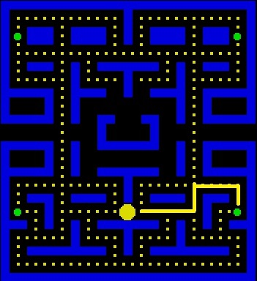
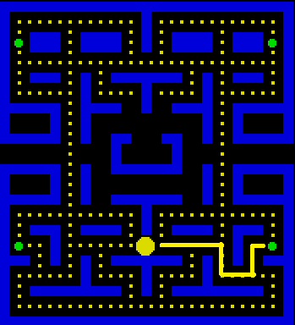
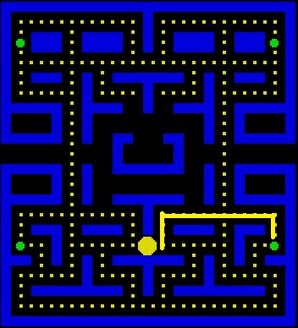
ACCESS PATH ?
Path chosen by the system to retrieve data after a SQL request is executed.

Slide 4
ACCESS PATH ?
How to find a “good” access path?

Slide 5
CONTENT
Processing of an SQL Statement
The Research Storage System
Costs for Single Relation Access Path
Access Path Selection
Nested Queries
Conclusion

Slide 6
PROCESSING OF SQL STATEMENT
An SQL query is subjected to 4 phases of processing.
PARSING
OPTIMIZATION
CODE GENERATION
EXECUTION

Slide 7
PROCESSING OF SQL STATEMENT
PARSING : checks for correct syntax
PARSING
OPTIMIZATION
CODE GENERATION
EXECUTION
SELECT COLUMN_NAME FROM TABLE WHERE <condition 1>

Slide 8
PROCESSING OF SQL STATEMENT
OPTIMIZATION :collects all the table and column references and checks for their existence.
PARSING
OPTIMIZATION
CODE GENERATION
EXECUTION

Slide 9
PROCESSING OF SQL STATEMENT
CODE GENERATION :translates the output of the optimizer to executable machine language.
PARSING
OPTIMIZATION
CODE GENERATION
EXECUTION

Slide 10
PROCESSING OF SQL STATEMENT
EXECUTION: the machine code is either executed immediately or later.
PARSING
OPTIMIZATION
CODE GENERATION
EXECUTION

Slide 11
PROCESSING OF SQL STATEMENT
EXECUTION: the machine code is either executed immediately or later.
PARSING
OPTIMIZATION
CODE GENERATION
EXECUTION
After execution, System R calls the internal storage system to scan the stored relations.

Slide 12
CONTENT
Processing of an SQL Statement
The Research Storage System
Costs for Single Relation Access Path
Access Path Selection
Nested Queries
Conclusion

Slide 13
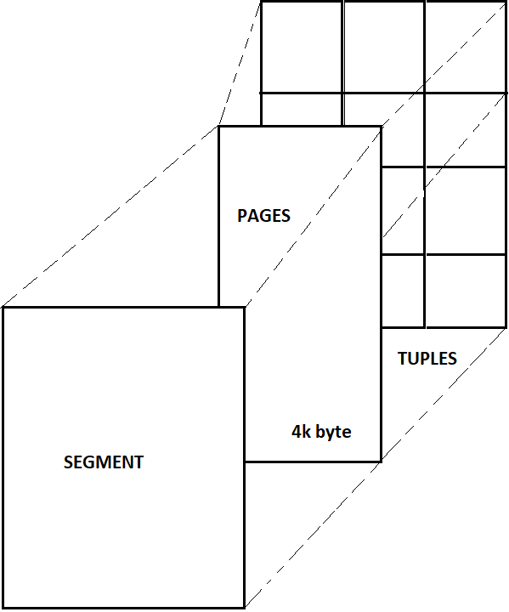
The Research Storage System (RSS)
Identification of relation
Storage sub-system of System R that maintains
Physical storage of relations
Access paths of these relations
Locking and Logging
Recovery services
The columns of the tuples are contiguous. No tuples span a page.
No relations span a segment.

Slide 14
The Research Storage System (RSS)
RSS Scans access tuples in a relations.
OPEN, NEXT and CLOSE are the principle commands on a scan.
Types of RSS Scan
Segment Scan
Index Scan

Slide 15
The Research Storage System (RSS)
Types of RSS Scan
Segment Scan
Index Scan
Finds all tuples of the given relation by scanning all related pages.
Indexes are created for relations and stored separately. Tuples are searched using these indexes
Both scans may take predicates called search arguments (SARGS).
SARGS are applied to the tuples before returning the result to RSI caller.

Slide 16
CONTENT
Processing of an SQL Statement
The Research Storage System
Costs for Single Relation Access Path
Access Path Selection
Nested Queries
Conclusion

Slide 17
Costs for Single Relation Access Path
COST = PAGE FETCHES + W*(RSI CALLS)
PAGE FETCHES : I/O operations
W : Adjustable weighting factor between I/O and CPU
RSI CALLS : The predicted number of tuples returned from RSS. The number of RSI calls is a good approximation for CPU utilization.

Slide 18
Costs for Single Relation Access Path
Statistics retrieved stored in System R catalog
For each relation T
NCARD(T) : The cardinality of relation T
TCARD(T) : The number of pages in the segment that holds tuples of relation T.
P(T) : The fraction of data pages in the segment that holds tuples of relation T. P(T) = TCARD(T) / No. of non-empty pages in the segment.
For each index I on relation T
ICARD(T) : The number of distinct keys in index I.
NINDX(T) : The number of pages in index I

Slide 19
Costs for Single Relation Access Path
SELECTIVITY FACTOR roughly corresponds to the expected fractions of tuples satisfying the predicate.
e.g. Column = value
F = 1 / ICARD(column index) if there is an index on column
F = arbitrary otherwise
e.g. Column BETWEEN value1 AND value2
F = (value2-value1) / (high key value – low key value)
A ratio of the BETWEEN value range to the entire key value range

Slide 20
Costs for Single Relation Access Path
Query Cardinality (QCARD) =
(cardinality of every relation in the FROM list ) *
(product of selectivity factors of all boolean factors)
For single relations, the cheapest access path is obtained by evaluating the cost of each available access path

Slide 21
CONTENT
Processing of an SQL Statement
The Research Storage System
Costs for Single Relation Access Path
Access Path Selection
Nested Queries
Conclusions

Slide 22
Access Path Selection
Outer relation : Relation from which a tuple will be retrieved first
Inner relation : Relation from which tuples will be retrieved, depending on the values obtained in the outer relation tuple.
Join predicate : A predicate which relates columns of two tables to be joined.
Join column: The column referenced in a join predicate

Slide 23
Access Path Selection (for 2-way Joins)
NESTED LOOPS METHOD
No particular order of scan
scans outer and inner relations
Result: composite tuple of outer-relation-tuple/inner-relation-tuple pairs
MERGING SCAN
Relations are scanned in join column order.
Applied on equi-joins.

Slide 24
Access Path Selection (for N-way Joins)
IF n RELATIONS, THEN n! JOINS
In joining relations t1, t2, t3, ..., tn only those orderings ti1, ti2, ti3, ..., tin are examined in which for all j (j=2, ..., n) either
tij has at least one join predicate with some relation tik, where k<j
Or
for all k > j, tik has no join predicate with ti1, ti2, ..., or ti(j-1)
T1 <-> T2
T2 <-> T3
T1 – T3 – T2
EXCLUDED!!!
T3 – T1 – T2

Slide 25
Access Path Selection
HOW TO FIND A “GOOD” PATH ?
HOW TO FIND A “GOOD” PATH ?
Create a possible solution tree
STEPS TO FOLLOW
Search is performed by finding the best way to join subsets of the relations.
For each relations, cardinality of the composite relations is saved.
For unordered joins, cheapest solution is saved
SOLUTION
Ordered list of relations to be joined
Join method used
Access method plan for each relation

Slide 26
Computation of Costs
The cost for joins are computed from the costs of the scans on each relations.
C-outer(path1) -> cost of scanning the outer relation via path 1
N -> cardinality of the outer relation tuples which satisfy the applicable
predicates:
N = (Product of cardinalities of all relations T of the join so far) *
(Product of selectivity factors of all applicable predicates)
C-inner(path2) -> cost of scanning the inner relation
C-nested loop join (path1,path2) = C-outer(path1) + N * C-inner (path2)
C-merge (path1,path2) = C-outer(path1) + N * C-inner (path2)

Slide 27
Example
EMP
NAME
SMITH
JONES
DOE
DNO
50
50
51
JOB
12
5
5
SAL
8500
15000
9500
DEPT
DNO
50
50
51
DNAME
MFG
BILLING
SHIPPING
LOC
DENVER
BOULDER
DENVER
JOB
JOB
12
5
5
TITLE
CLERK
TYPIST
SALES
MECHANIC
SELECT NAME, TITLE, SAL, DNAME
FROM EMP, DEPT, JOB
WHERE TITLE=“CLERK”
AND LOC =“DENVER”
AND EMP.DNO = DEPT.DNO
AND EMP.JOB = JOB.JOB

Slide 28
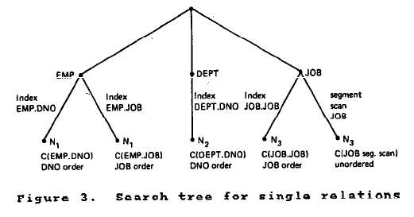
Example

Slide 29
CONTENT
Processing of an SQL Statement
The Research Storage System
Costs for Single Relation Access Path
Access Path Selection
Nested Queries
Conclusions

Slide 30
Nested Queries
SELECT NAME
FROM EMPLOYEE
WHERE SALARY =
( SELECT AVG(SALARY)
FROM EMPLOYEE )
SELECT NAME FROM EMPLOYEE
WHERE DEPNO IN
( SELECT DEPNO
FROM DEPARTMENT
WHERE LOCATION=“DENVER” )
Subquery is evaluated before the main query and is evaluated only once.
SELECT NAME
FROM EMPLOYEE X
WHERE SALARY > ( SELECT SALARY
FROM EMPLOYEE
WHERE EMPLOYEE_NUMBER=X.MANAGER)
Correlation Subquery must be re-evaluated for each candidate tuple from the referenced query block.

Slide 31
CONTENT
Processing of an SQL Statement
The Research Storage System
Costs for Single Relation Access Path
Access Path Selection
Nested Queries
Conclusion

Slide 32
Conclusion
True optimal path was selected in majority of the cases.
Key contributors: expanded use of statistics , inclusion of CPU utilization in cost calculations, method to determine join order
More work on validation of the optimizer cost formulas needs to be done, but this preliminary work shows that database management systems can support non-procedural query languages with performance comparable to those supporting the current more procedural languales.

Slide 33
Thank you!

